Slide 1
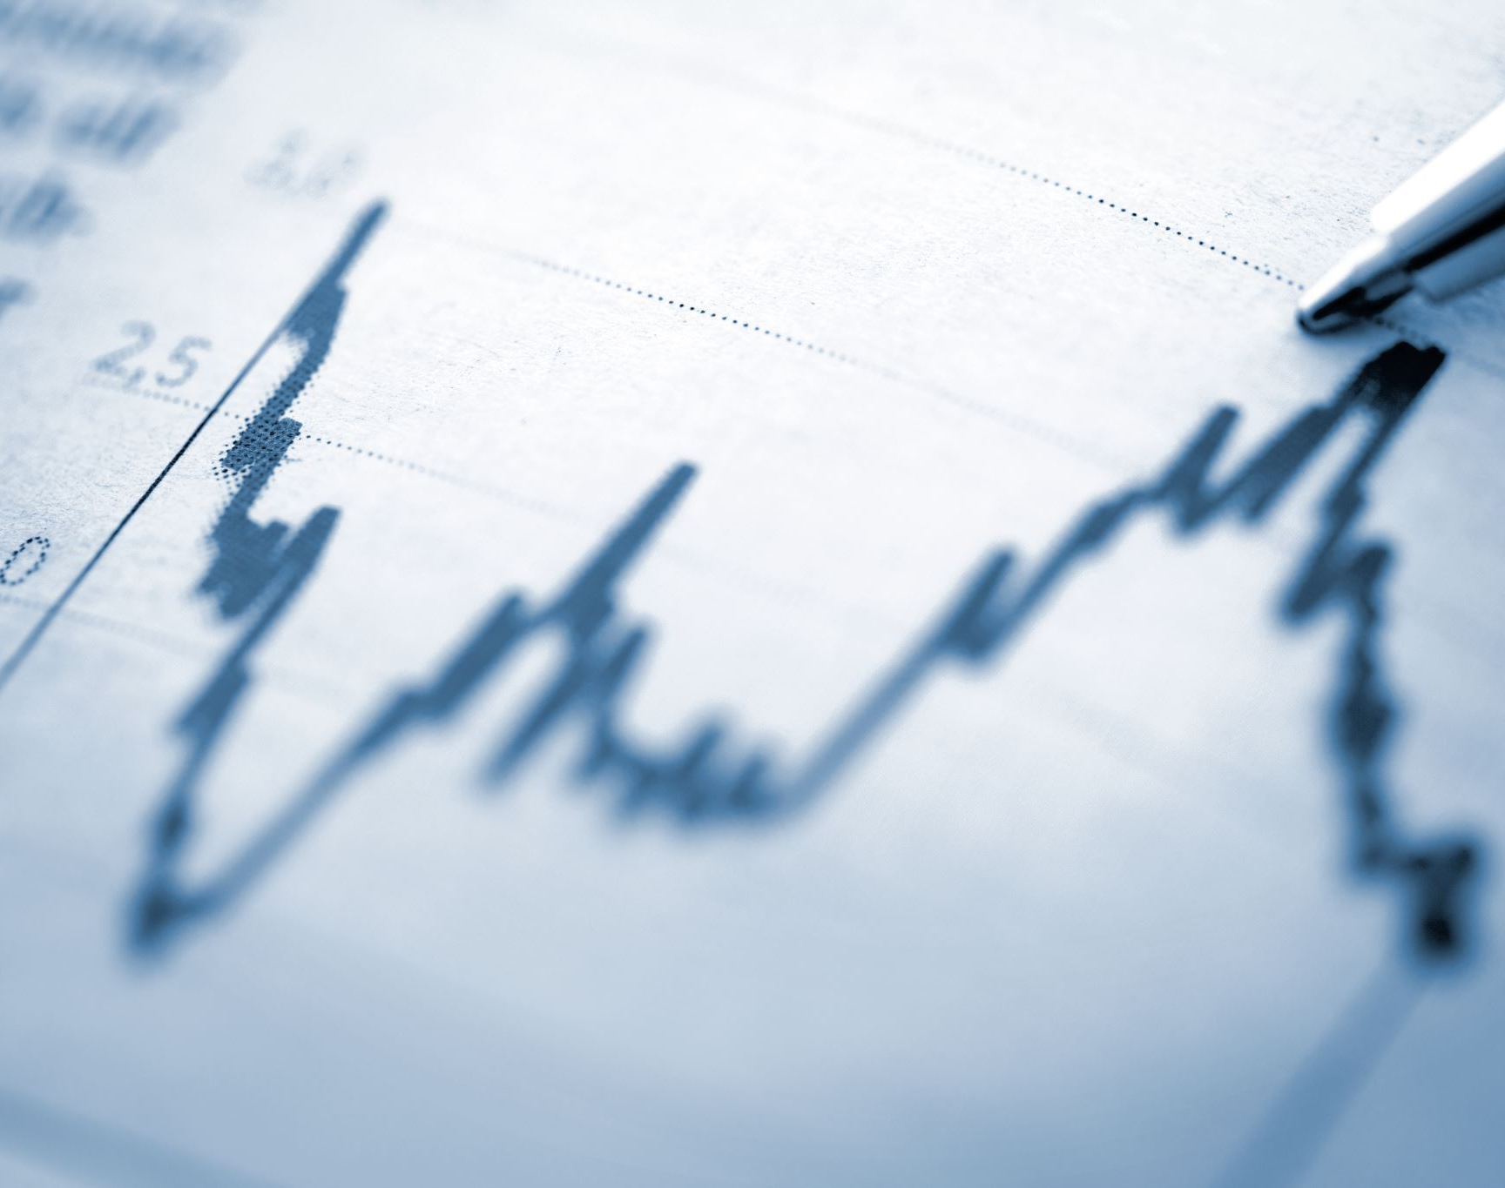
Brand Equity Meta-analysis
Mike Nguyen
University of Missouri
Notes:
20 mins presentation
Remember to use the word “I”
Hi y’all, I am glad you are here to join me in my presentation regarding the meta-analysis of brand equity

Slide 2
Brand Equity and Brand Performance
Brand Equity
Brand Performance
?
Notes:
Is there anyone here who thinks there is not a positive correlation between brand equity and brand performance?

Slide 3
Brand Equity and Brand Performance
Brand Equity
Brand Performance
+
Notes:
Is there anyone here who thinks there is not a positive correlation between brand equity and brand performance?

Slide 4
Brand Equity and Brand Performance
Correlation |  | Brand Performance
 |  | Objective | Subjective
Brand Equity | Objective
 | Subjective

Slide 5
Brand Equity and Brand Performance
Correlation |  | Brand Performance
 |  | Objective | Subjective
Brand Equity | Objective | ? | ?
 | Subjective | ? | ?

Slide 6
Social Media
This Photo by Unknown Author is licensed under CC BY-NC-ND
This Photo by Unknown Author is licensed under CC BY-SA-NC
Notes:
Ask about social media change over time would it has any effect on brand equity how social media changes thing Is brand equity more or less important in the social media world

Slide 7
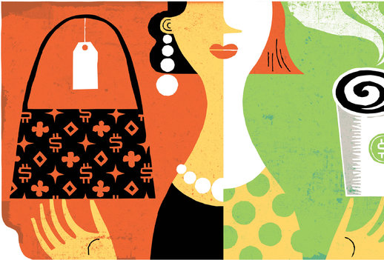
Conspicuous Consumption

Slide 8
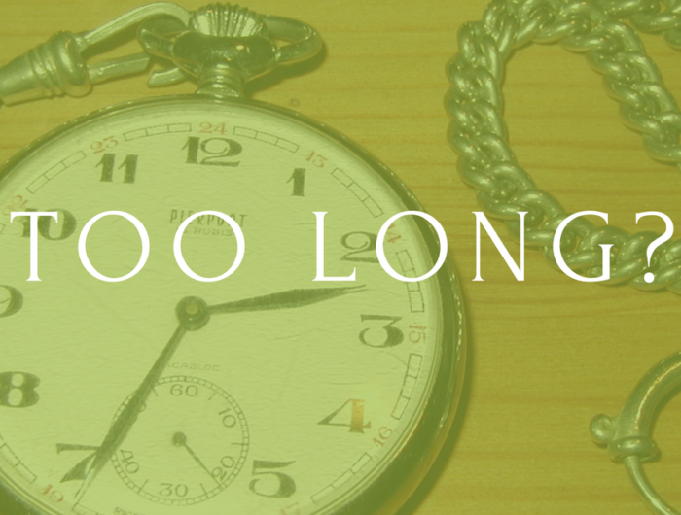
Reasons for a meta-analysis
30 years after Marketing Science Institute called for research on brand equity
No systematic review on how brand equity affects brand performance.
No systematic operationalization of “brand equity”
No overview of what has been studied with brand equity -> future direction?
Notes:
Why should we still need to do this meta analysis

Slide 9
Research Questions
What is the strength of the cor(BE,BP)?
How does social media affect the BE-BP relationship?
Does the BE-BP relationship differ for conspicuous vs. inconspicuous products?
Social Media
Brand Equity
?
Brand Performance
?
?
Conspicuous Consumption
Notes:
Those reasons motivate me to conduct this meta-analysis.
In this paper, I study the relationship between brand equity and brand performance.
There are three general research questions that I try to answer from this research (list them out)
It’s been 30 years after the first call for research on brand equity by the MSI. And there is not yet a single meta-analysis on how brand equity affects firm performance.
One of the reasons why this is the case is that there is no consensus on how one defines brand equity
Without an overview of what has been studied in the brand equity literature, it’s hard for researchers to have a clear agenda for future research.

Slide 10
Research Questions
What is the strength of the relationship between brand equity and brand performance?
What is the effect of social media on this relationship?
Is there a difference regarding cor(BE, BP) between conspicuous and inconspicuous products?
Notes:
Those reasons motivate me to conduct this meta-analysis.
In this paper, I study the relationship between brand equity and brand performance.
There are three general research questions that I try to answer from this research (list them out)
It’s been 30 years after the first call for research on brand equity by the MSI. And there is not yet a single meta-analysis on how brand equity affects firm performance.
One of the reasons why this is the case is that there is no consensus on how one defines brand equity
Without an overview of what has been studied in the brand equity literature, it’s hard for researchers to have a clear agenda for future research.

Slide 11
Conceptualization of Brand Equity
Value assigned to a branded entity
Value assigned to a generic entity
Brand Equity
Value assigned to a generic entity
Value assigned to a branded entity
Notes:
First, we need to conceptualize brand equity. It’s usually thought of as the value that consumers are willing to pay for a branded product that is above and beyond the value assigned to a generic product.

Slide 12
Brand Equity Definitions
Articles | Brand Equity Definitions
Farquhar (1989) | “added value with which a given brand endows a product.”
Keller (1993) | “the marketing effects uniquely attributable to the brand.”
Aaker (1996) | “a set of assets (and liabilities) linked to a brand’s name and symbol that adds to (or subtracts from) the value provided by a product or service to a firm and/or that firm’s customers.”
Notes:
Formally, according to the easiest definition by Farquhar 1989, it’s the added value with which a given brand endows a product
However, the more well-known definition are those by Keller (1993) and Akker (1996)
Thanks to the root

Slide 13
Conceptualization of Brand Equity
Brand Equity
Financial-based
Other
(e.g., Employee-based)
Customer-based
A slide view of Brand Equity from different perspectives
Notes:
There are mainly three perspectives that authors usually take when studying brand equity
Financial-based (which is analogous with the firm-perspective )
Consumer-based
Other; such as employee-based

Slide 14
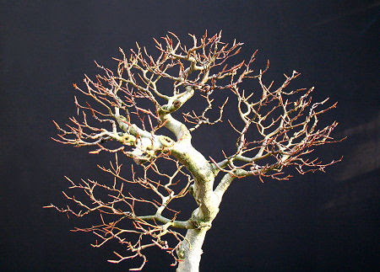
Divergence
Notes:
Because of the growth and ramification of brand equity as a construct, it can jeopardize the validity of a meta-analysis that studies brand equity.
Consider dropping this slide (by Lisa)

Slide 15
Convergence
Agarwal and Rao (1996)
Perception and Attitude
Performance
Choice intention
Actual choice (Sales)
Aaker’s (1991)
Keller’s (1993)
Customer vs. firm perspective
Adapted from Yoo and Donthu’s (2001) vs. Created
Notes:
However, we are fortunate that we find evidence this is not the case.
Even though there are divergences in the construct definition, most of the definitions are still derived from Aaker’s (1991) and Keller’s (1993). Moreover, empirically we found no difference in the relationship of brand equity and brand performance between those papers that measured from the firm perspective and those measured from the customer perspective, (2) those papers used the measurement scale developed by Yoo and Donthu (2001) and those that developed themselves.
Empirical evidence for the no differences is consistent with Agarwal and Rao (1996)’s ding where they compare different measures of brand equity for the same products from various perspectives such as perceptions, attitude, performance, choice intention, and actual choice.
They found that there was a high convergent between these measures, which means that they are appropriate indirect brand equity measures as conceptualized by Aaker (1991) and Keller (1993).
Basically, If authors stay faithful to Aaker and Keller’s definition of brand equity in their construct definitions, they are likely to measure brand equity.

Slide 16
Brand Performance
Objective
Subjective
Revenue/Sales
Purchase Intention
Profit
ROA
ROI
Brand Preference
Notes:
Those are my initial text analysis. And this section I will come back to meta-analysis.

Slide 17
Search Process
All accessible databases
Inclusion Criteria
Exclusion Criteria
364 potential papers
All sources in English
Cor (BE, BP)
Insufficient data
Conceptual papers
Outlier
Notes:
Having established that it’s feasible to conduct a meta-analysis on brand equity, we proceed to the Search Process
On March 24^{th,} 2020, we search all available databases such as Springer, Sage Wiley Online Library, Elsevier/ Then we also use ancestry-search from the references section of key conceptual articles and leading brand equity researchers’ articles before 1991.
Since in 1991, MSI introduced and popularized the term brand equity, before 1991 authors might refer to the same construct with different names. Moreover, we also examined MSI’s relevant knowledge series on brand equity and brand equity.
To address the file drawer problem or unpublished data issues, we request the ELMAR group, and search on other dissertation databases from a public university. Lastly, we also email the top 10 prolific researchers from the results of the text mining and bibliometrix analysis.
All sources which mean All published papers, and Unpublished papers from dissertations, theses, and insignificant result database.
Conference proceedings.

Slide 18
Search Process
All accessible databases
Inclusion Criteria
Exclusion Criteria
364 potential papers
Address file drawer problem
Contact authors for additional info
Thesis Databases
ELMAR
Top Authors
Related Search (Mendeley)
Ancestry Search
90 usable papers
Sent | 259
Couldn’t deliver | 38
No reply | 191
Couldn’t find info | 10
Found info | 20
Notes:
Having established that it’s feasible to conduct a meta-analysis on brand equity, we proceed to the Search Process
On March 24^{th,} 2020, we search all available databases such as Springer, Sage Wiley Online Library, Elsevier/ Then we also use ancestry-search from the references section of key conceptual articles and leading brand equity researchers’ articles before 1991.
Since in 1991, MSI introduced and popularized the term brand equity, before 1991 authors might refer to the same construct with different names. Moreover, we also examined MSI’s relevant knowledge series on brand equity and brand equity.
To address the file drawer problem or unpublished data issues, we request the ELMAR group, and search on other dissertation databases from a public university. Lastly, we also email the top 10 prolific researchers from the results of the text mining and bibliometrix analysis.
Among the 30 who replied . .
All sources which mean All published papers, and Unpublished papers from dissertations, theses, and insignificant result database.
Conference proceedings.

Slide 19
Search Process
All accessible databases
Inclusion Criteria
Exclusion Criteria
364 potential papers
Address file drawer problem
Contact authors for additional info
90 usable papers
Studies with multiple measures
Papers with multiple studies
106 observations
Notes:
Having established that it’s feasible to conduct a meta-analysis on brand equity, we proceed to the Search Process
On March 24^{th,} 2020, we search all available databases such as Springer, Sage Wiley Online Library, Elsevier/ Then we also use ancestry-search from the references section of key conceptual articles and leading brand equity researchers’ articles before 1991.
Since in 1991, MSI introduced and popularized the term brand equity, before 1991 authors might refer to the same construct with different names. Moreover, we also examined MSI’s relevant knowledge series on brand equity and brand equity.
To address the file drawer problem or unpublished data issues, we request the ELMAR group, and search on other dissertation databases from a public university. Lastly, we also email the top 10 prolific researchers from the results of the text mining and bibliometrix analysis.
All sources which mean All published papers, and Unpublished papers from dissertations, theses, and insignificant result database.
Conference proceedings.

Slide 20
Conceptual Framework & Hypotheses
Hypotheses
Brand Performance: Consumer-based > Financial-based
Conspicuous Consumption: Public > Private
Social Media Intro: Before > After
Product Consumption x Social Media: Social Media increases the gap between Public and Private consumption products
Control
Data Structure: Panel < Cross-sectional
Random Selection: Yes > No
Product Type: Goods vs. Service
Brand Equity
Brand Performance
+

Slide 21
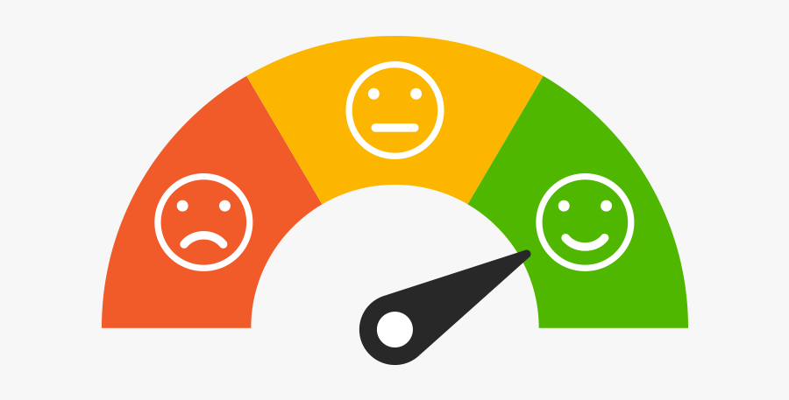
Brand Performance Measurement
Consumer-based
Brand Performance
Financial-based
Brand Performance
This Photo by Unknown Author is licensed under CC BY

Slide 22
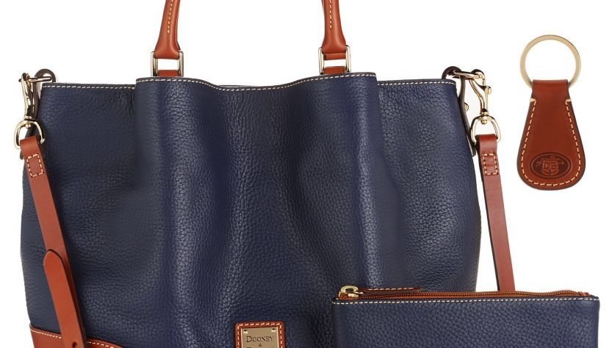
Conspicuous Consumption
Public / Conspicuous Consumption
Private / Inconspicuous Consumption
This Photo by Unknown Author is licensed under CC BY

Slide 23
Social Media Introduction
Before Social Media
After Social Media
This Photo by Unknown Author is licensed under CC BY-NC-ND
This Photo by Unknown Author is licensed under CC BY

Slide 24
Social Media Introduction
Before Social Media
After Social Media
This Photo by Unknown Author is licensed under CC BY-NC-ND
This Photo by Unknown Author is licensed under CC BY

Slide 25
Conceptual Framework
Brand Performance: Consumer-based > Financial-based
Conspicuous Product: Public > Private
Social Media Intro: Before > After
Product x Social Media: Social Media enhances public - private product gap
Controls
Data Structure: Panel < Cross-sectional
Random Selection: Yes > No
Product Type: Goods vs. Service
Brand Equity
Brand Performance
+

Slide 26
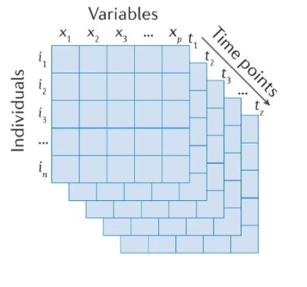
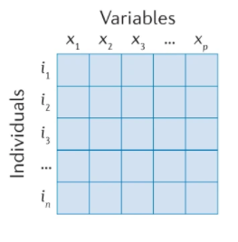
Conceptual Framework
Notes:
Original picture by https://www.nature.com/articles/s43586-021-00055-w/figures/3

Slide 27
Conceptual Framework

Slide 28
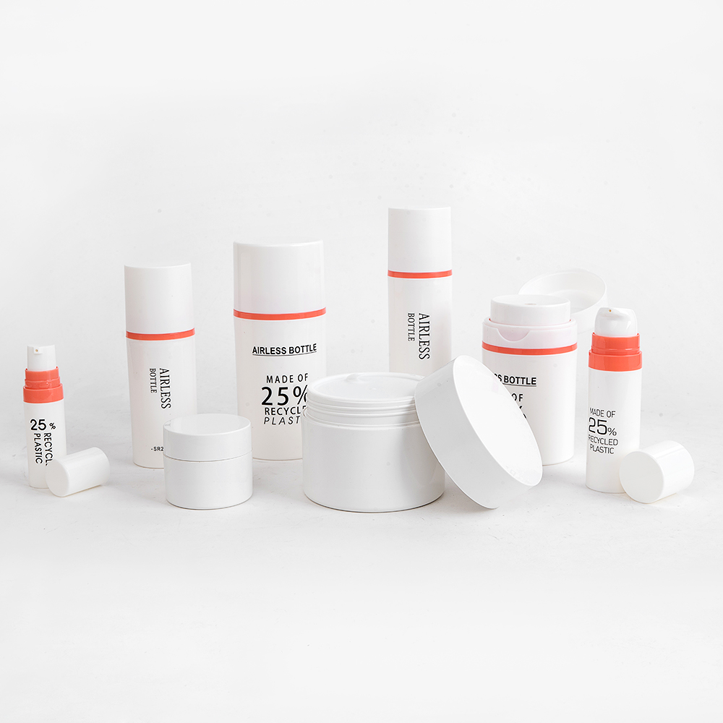
Conceptual Framework

Slide 29
Model Free Evidence
Without any assumption, using the method-of-moment estimator
Handle dependent effect sizes (without any info on the nature of the within-study covariance)
An extension of the heteroskedasticity-robust and clustered standard errors in the general linear model.
Robust against non-normality
Small-sample correction: robust against
Small samples
Highly skewed and unbalanced data

Slide 30
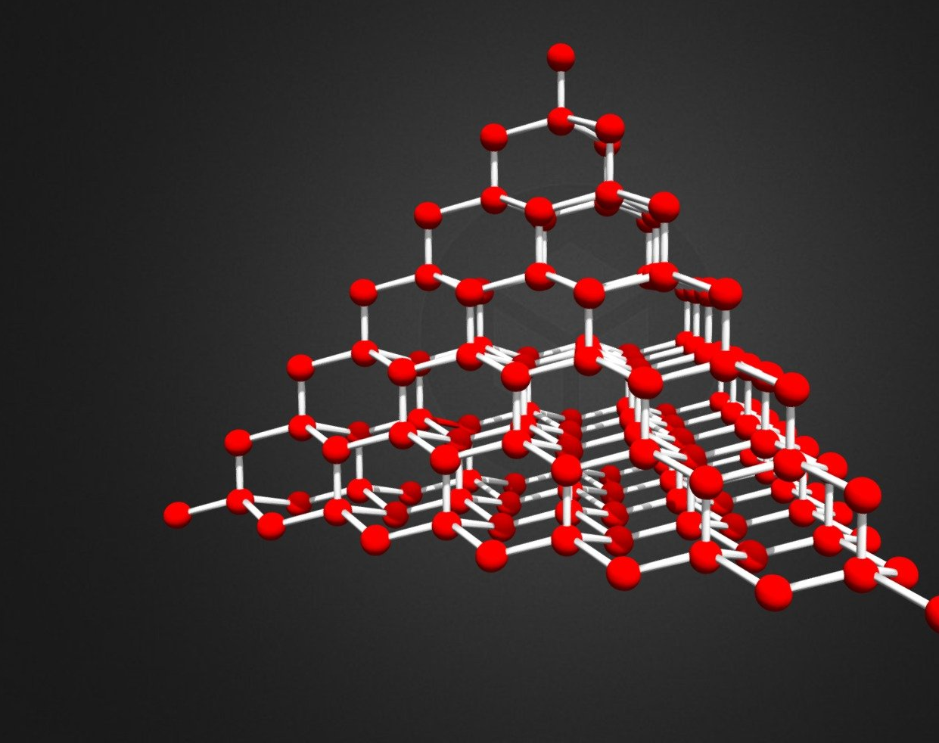
Challenges
Levels of potential dependence
Effect sizes nested within a sample
Samples nested within a study
Studies nested within an article
Dependence Structures
Hierarchical Structure (Authors/Articles estimate effect sizes)
Correlated Structure (Effect sizes in the same sample or same sample in different articles)
This Photo by Unknown Author is licensed under CC BY
Notes:
(1) multiple effect sizes (from different brand performance measurements) nested within samples, (2) samples nested within studies, and (3) studies nested within authors/articles

Slide 31
Solution
PECHE+ model proposed by Pustejovsky and Tipton (2020, p. 15)
PEC: Partially empirical correlations assumption
HE: Hierarchical effect
Can handle :
Within sample
Between sample
Between-article
Random Effects

Slide 32
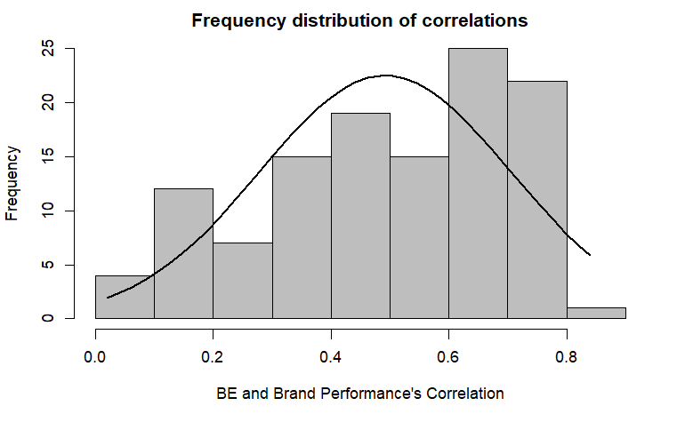
Frequency Distribution of Correlations

Slide 33
Results
 | Estimator | Correlation | Standard Error
Model Free Evidence | Method-of-moment | 0.48 | 0.023
Account for the dependence structure | REML | 0.54 | 0.003

Slide 34
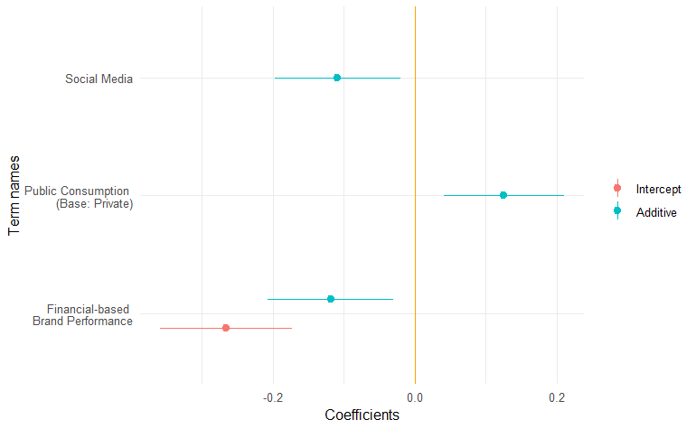
Model Comparison
Notes:
Following Roschk and Hosseinpour (2020), we see that the moderators (i.e., indicators of within-sample variance in effect sizes) can account for an additional 26.25% of the heteroskedasticity after accounting for the dependence structure. Compared to other meta-analyses (e.g., Roschk and Hosseinpour (2020, p. 136) accounted for 12.6%), this study’s moderators account for a substantial amount of variance However, if we consider the univariate structure (i.e., do not account for the dependence structure), there is an increase of 94% in terms of pseudo R-squared. (but I am not sure if I should say it in the paper)
For the moderation effect of social media on the observability of product consumption, we used the Johnson-Neyman technique (Johnson & Fay, 1950) to probe the significance area. The conditional effect of observability is significant after the introduction of social media. Moreover, we also plotted both the simple and interaction effects of social media and observability.

Slide 35
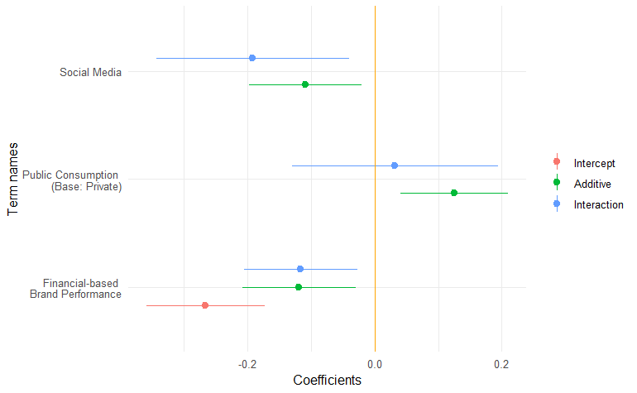
Model Comparison

Slide 36
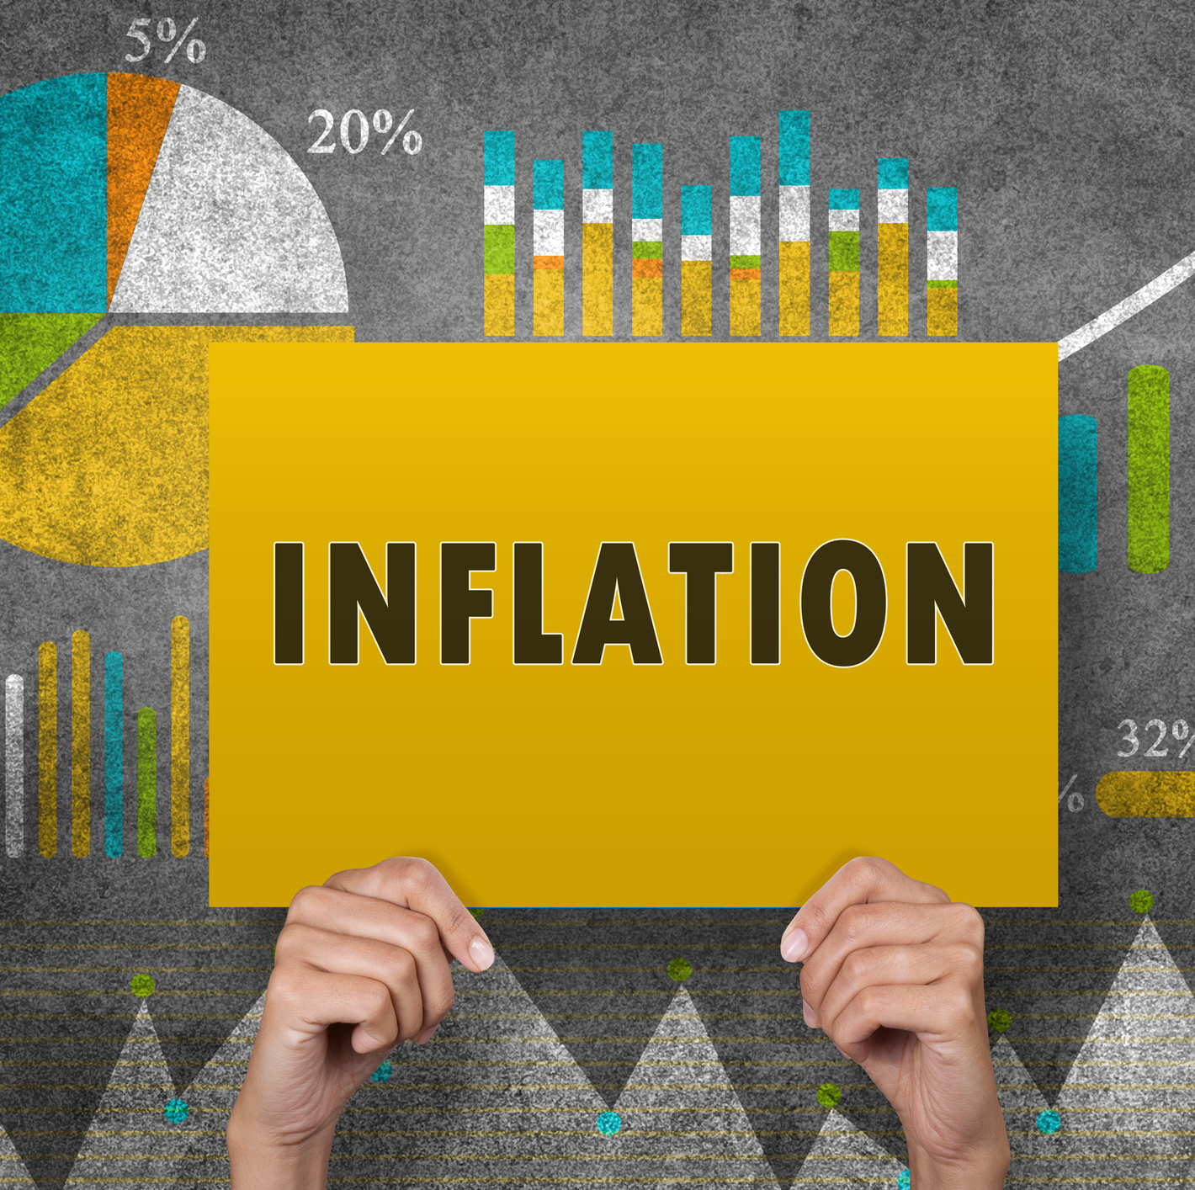
What if?
Using subjective BP inflates the cor(BE,BP) by 25%
Subjective Brand Performance?
Researchers
Managers
Incorporate prior studies into the correlation using the Bayesian method.
R code (sample size, new correlation, alpha-level)

Slide 37
Simulation Table
 | Correlation (BE, Subjective BP)
Sample Size | 0.4 | 0.5 | 0.6 | 0.7 | 0.8 | 0.9
50 | 0.21 | 0.21 | 0.21 | 0.21 | 0.21 | 0.21
100 | 0.21 | 0.21 | 0.21 | 0.21 | 0.21 | 0.21
200 | 0.21 | 0.21 | 0.21 | 0.21 | 0.21 | 0.21
300 | 0.21 | 0.21 | 0.21 | 0.21 | 0.21 | 0.21
400 | 0.21 | 0.21 | 0.21 | 0.21 | 0.21 | 0.22
500 | 0.21 | 0.21 | 0.21 | 0.21 | 0.21 | 0.22
1000 | 0.21 | 0.21 | 0.22 | 0.22 | 0.22 | 0.23
2500 | 0.22 | 0.22 | 0.23 | 0.24 | 0.25 | 0.26
5000 | 0.22 | 0.24 | 0.25 | 0.26 | 0.28 | 0.31
10000 | 0.24 | 0.26 | 0.28 | 0.31 | 0.34 | 0.4
Notes:
One important implication: For different sample sizes, and correlations, what the correction should look like.
For example, ….
Circle animation when you talk about the example.

Slide 38
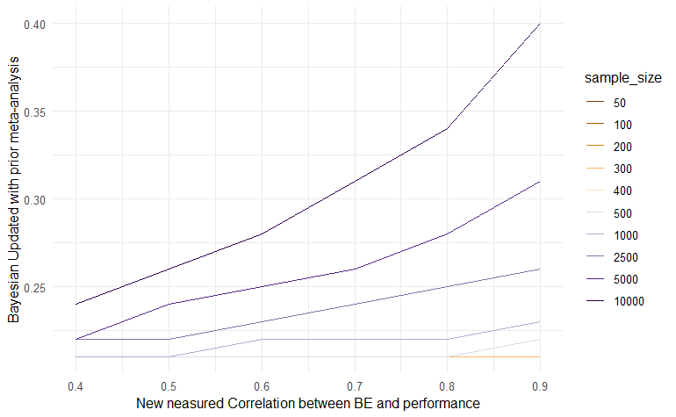
Simulation Visualization
Notes:
Visualize the finding in the previous table, the correlation between BE and BP go up, so does the gap wider between the true and observed correlation.

Slide 39
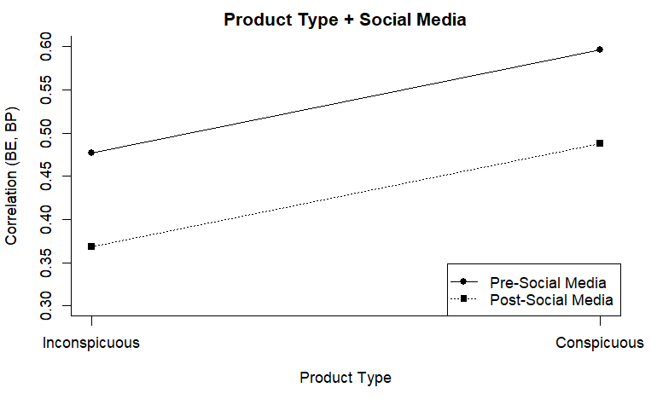
Additive Model
Notes:
Additive = Social Media + Conspicuous Consumption

Slide 40
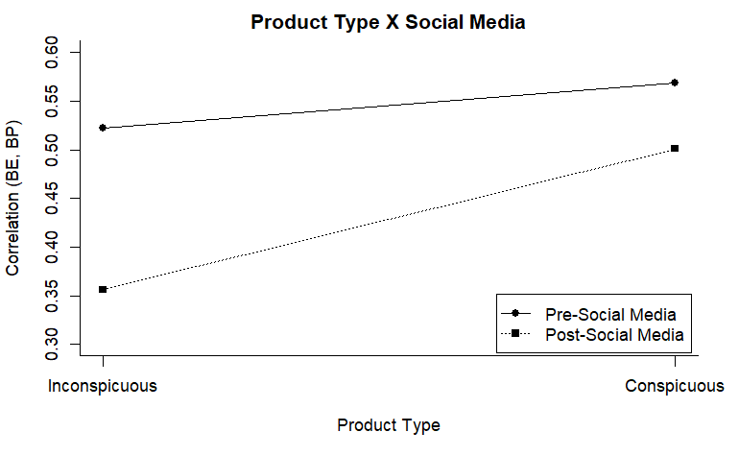
Interaction Model
Notes:
Interaction = Social Media x Conspicuous Consumption

Slide 41
Robustness Checks
Social media date:
Consistent 2008 - 2012
Journal quality:
h-index, ScImago Rank, Impact score, Resurchify impact factor
Bayesian estimation:
0.49 (0.22)
Notes:
Even though the frequentist approach estimates a parameter well under a study with a large sample size, we alternatively applied the Bayesian approach to integrate our prior knowledge and assumption regarding the relationship between brand equity and brand performance. The Bayesian method allowed us to quantify the uncertainty when estimating tau-squared. Moreover, the Bayesian approach outperforms conventional methods in estimating heterogeneity and pooled effect (Harrer et al., 2019). Following Williams et al. (2018), we assumed the prior distribution of the pooled effect size to follow a normal distribution (i.e., μ ~ N(0.5,0.3)), which is considered as weakly informative prior as compared to non-informative (uniform distribution). Furthermore, we assumed the between-study heterogeneity (tau) to follow the Half-Cauchy distribution since it is only defined for the positive side of the distribution. Following Harrer et al. (2019), a conservative scaling parameter of 0.5 and a sensitivity analysis with this parameter ranging from 0.5 to 4 was used. Accordingly, we had a tau prior: τ ~ HC(0, 0.5). Using the Markov Chain Monte Carlo algorithm with 10,000 iterations, we obtained a converged model with an estimate consistent with REML and method-of-moment approach, which is β = 0.49 and SE = 0.22.

Slide 42
Takeaways

Slide 43
Measurement Matters!
Brand Equity: 👍
Beware when you measure brand performance subjectively
Correct for it with the Bayesian method

Slide 44
Brand Equity and Brand Performance
Correlation |  | Brand Performance
 |  | Objective | Subjective
Brand Equity | Objective | ? | ?
 | Subjective | ? | ?

Slide 45
Brand Equity and Brand Performance
Correlation |  | Brand Performance
 |  | Objective | Subjective
Brand Equity | Objective | ? | ?
 | Subjective | ? | ?

Slide 46
Brand Equity and Brand Performance
Correlation |  | Brand Performance
 |  | Objective | Subjective
Brand Equity | Objective
 | Subjective
This Photo by Unknown Author is licensed under CC BY

Slide 47
Conspicuous Consumption
BE-BP relationship is stronger for Conspicuous Products

Slide 48
In the Social Media Age
The BE-BP relationship is weaker
Widens the gap between conspicuous and inconspicuous products.
This Photo by Unknown Author is licensed under CC BY-NC-ND

Slide 49
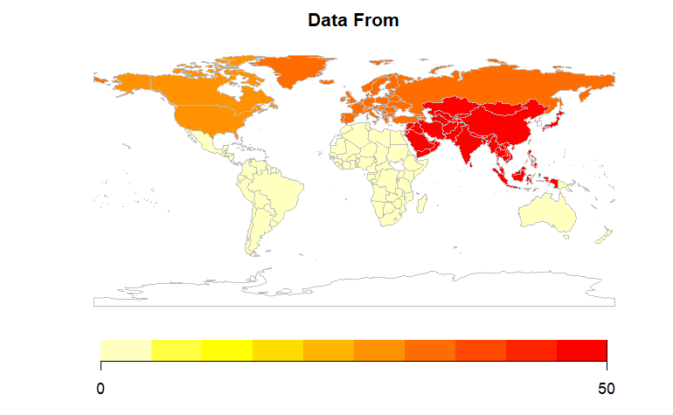
Generalizability
Notes:
One paper can have data set from multiple countries (i.e.,, multiple continents)
There are two limitations regarding my meta-analysis which are the generalizability problem and study level. Regarding generalizability, studies in my analyses are only in English and most of the companies are in the US. Accordingly, it might be questionable to genialize the finding to other companies outside of the US. we can only look at moderators at the study level. Hence, we cannot probe in to the firm’s specific heterogeneity

Slide 50
Thank you for listening

Slide 51
References
Aaker, D. A. (1996). Measuring Brand Equity Across Products and Markets. California Management Review. https://doi.org/10.2307/41165845
Agarwal, M. K., & Rao, V. R. (1996). An empirical comparison of consumer-based measures of brand equity. Marketing Letters, 7(3), 237–247. https://doi.org/10.1007/BF00435740
Anselmsson, J., & Bondesson, N. (2015). Brand value chain in practise; the relationship between mindset and market performance metrics: A study of the Swedish market for FMCG. Journal of Retailing and Consumer Services, 25, 58–70.
Farquhar, P. H. (1989). Managing Brand Equity. Marketing Research.
Keller, K. L. (1993). Conceptualizing, Measuring, and Managing Customer-Based Brand Equity. Journal of Marketing. https://doi.org/10.2307/1252054
Pustejovsky, J. E., & Tipton, E. (2020). Meta-Analysis with Robust Variance Estimation: Expanding the Range of Working Models. https://doi.org/10.31222/osf.io/vyfcj
Yoo, B., Donthu, N., & Lee, S. (2000). An examination of selected marketing mix elements and brand equity. Journal of the Academy of Marketing Science, 28(2), 195–211. https://doi.org/10.1177/0092070300282002

Slide 52
Coding Scheme
Variable | Operationalization/ Variable Description
Brand Performance | Was brand performance measured subjectively or objectively? (1) Subjective (2) Objective
Observability of Product Consumption | Where is the product typically consumed? (1) Private (2) Mixed (3) Public
Social Media Introduction | Were the data collected before or after 2012? (1) Before (2) After For panel data, we measure the percent of years after 2012 over the total number of years Papers with missing data on data collection year are assumed to be collected two years before the publication
Data Structure | Did the study measure brand at one or multiple points in time? (1) Cross-sectional (2) Panel
Random Selection | Was the source/perspective of brand equity selected randomly? (1) Random (2) Non-random
Product Type | What is the main offering of the focal entity? (1) Goods (2) Mixed (3) Service

Slide 53
Outlier
Analyses
Boxplots
Influential diagnostics (e.g., leave-one-out method, DIFFITS, value, Cook’s distances, covariance ratio)
Baujat analysis
Anselmsson & Bondesson (2015) with r > 0.9.

Slide 54
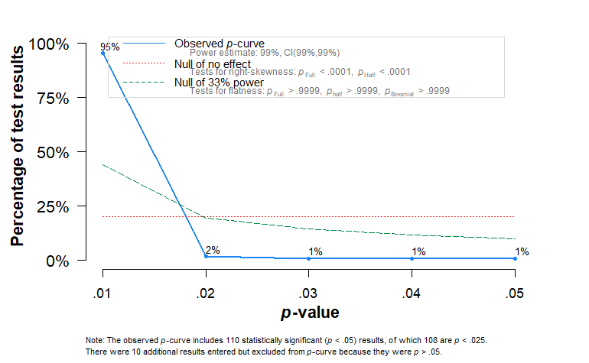
P-curve Analysis

Slide 55
Model Comparison
 | Intercept | Additive | Interaction
Constant | 0.54 *** | 0.52 *** | 0.59 ***
 | (0.02) | (0.06) | (0.08)
Financial-based Brand Performance | -0.27 *** | -0.12 ** | -0.12 *
 | (0.05) | (0.05) | (0.05)
Product Consumption Observability |  | 0.13 ** | 0.03
 |  | (0.04) | (0.08)
Social Media Introduction |  | -0.11 * | -0.19 *
 |  | (0.05) | (0.08)
Interaction |  |  | 0.13
 |  |  | (0.10)
Data Structure (Base: Cross-sectional) |  | -0.20 ** | -0.22 **
 |  | (0.07) | (0.07)
Random Selection |  | 0.11 ** | 0.10 **
 |  | (0.04) | (0.04)
Product Type Mix (Base: Goods) |  | -0.05 | -0.05
 |  | (0.05) | (0.05)
Product Type Service (Base: Goods) |  | -0.04 | -0.04
 |  | (0.04) | (0.04)
deviance | -57.00 | -78.46 | -78.56
AIC | -49.00 | -58.46 | -56.56
BIC | -38.42 | -32.61 | -28.24
AICc | -48.59 | -55.93 | -53.46
nobs.1 | 106.00 | 106.00 | 106.00
Standard errors are heteroskedasticity robust. *** p < 0.001; ** p < 0.01; * p < 0.05.

Slide 56
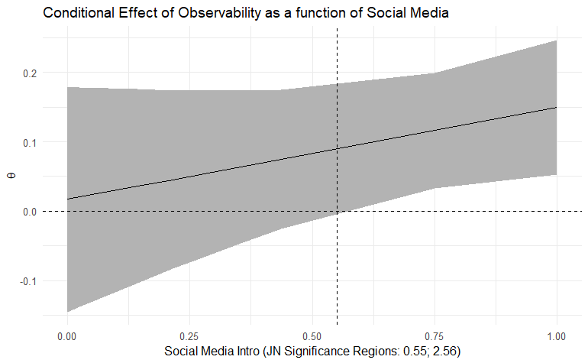
Johnson-Neyman plot

Slide 57
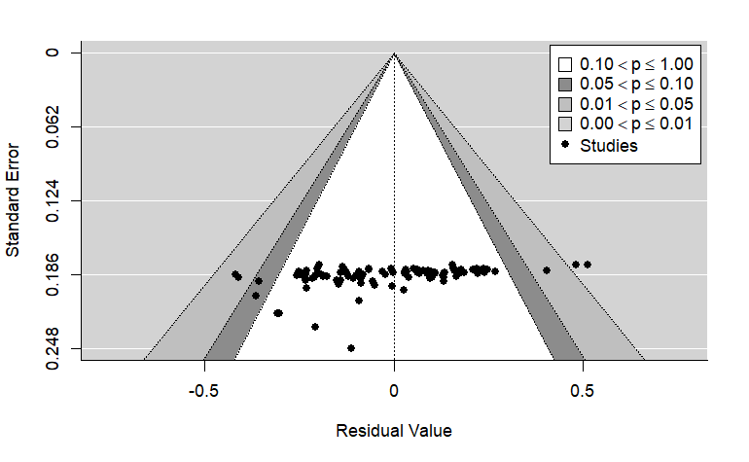
Contour-Enhanced Forest Plot
Fail-safe N
Rosenthal’s (n = 973,009) Rosenberg’s (n = 979,279)
Orwin’s (n = 106)
Notes:
Rosenthal’s (n = 973,009), Rosenberg’s (n = 979,279), and Orwin’s (n = 106) fail-safe N (Rosenberg, 2005; Rosenthal, 1979)

Slide 58
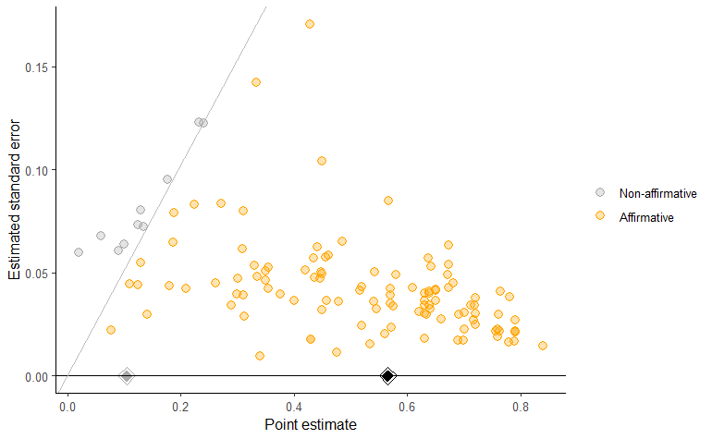
Significance Funnel
Notes:
Following Mathur and VanderWeele (2020), we plot the significance plot in Figure 10 (modified funnel plot/ significance plot) that detects the difference between non-affirmative studies’ point estimates (grey diamond) and that of affirmative studies (black diamond). The corrected estimate is still substantial (above 0.1), even in the worst-case publication bias. We also examined the contour-enhanced funnel plot, which showed the symmetrical distribution of studies (Figure 11), indicating unlikely publication bias (Peters et al., 2008). In Figure 12 Eta Sensitivity Plot), we can observe that up until the affirmative studies are 50 times more likely to be published than non-affirmative studies, the effect between brand equity and brand performance is still above 0.2. Moreover, the significant effect between brand equity and performance is still present even when this ratio reaches 200. Furthermore, after estimating the S-value (i.e., the severity of publication bias), the effect of brand equity on brand performance cannot be “explained away.”
Check again

Slide 59
Contact Authors
Reason | Number
Email sent | 259
Email couldn’t deliver | 38
Authors couldn’t find information | 10
Authors found information | 20
No reply from authors | 191

Slide 60
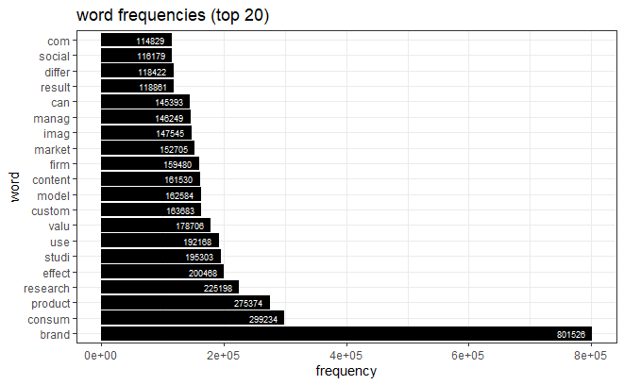
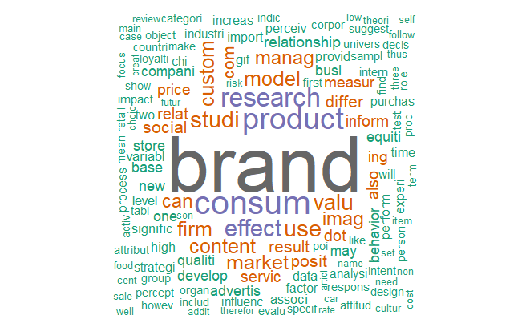
Overview of the academic landscape
Notes:
Text mining was done based on step 3 documents only.
Thanks to High Performance Computing, I was able to extract the following insights from the brand equity and value corpus.
As you can see, the top frequently used words are brand, consum (as in consumer, or consume), and value, firm, image, and social
Which is consistent with my hypothesis regarding brand equity’s nomological network.
Word Cloud associated with brand equity, network analysis.

Slide 61
5 Topic Modeling
product, firm, price, effect, model, market, use
content, dot, com, store, image, chi, poi
brand, consumer, research, product, studi, effect, custom
manage, business, market, research, can, develop,
social, consum, studi, behavior, car, media, food

Slide 62
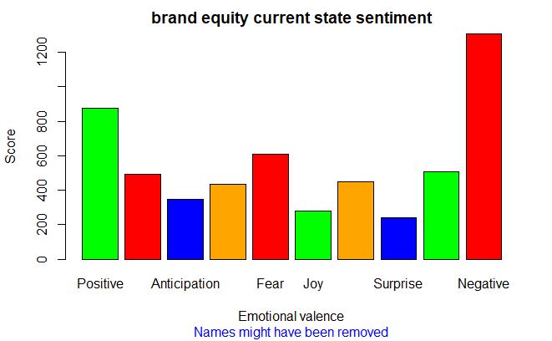
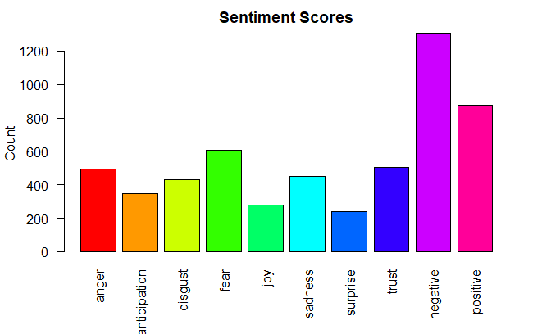
Sentiment Analysis
Notes:
The sentiment analysis reveals a surprising insight in the branding literature that most of them are actually negative.

Slide 63
Bibliometrix Analysis
Notes:
We conduct further bibliometrix analysis on 5913 from Scopus and Clarivate Analytics Web of Since
There are almost 10,000 authors work in this space (9757)

Slide 64
Author’s Frequency Distribution
Authors | Articles
Gil-Saura I | 29
Keller KL | 28
De Charnatony L | 22
Christodoulides G | 19
Pike S | 19
Merrilees B | 16
Tasci Ada | 16
King C | 15
Wang Y | 15
Zhang J | 15

Slide 65
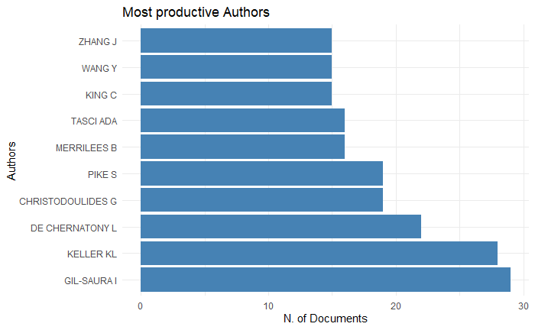
Most Productive Authors

Slide 66
Author’s Frequency Distribution (Fractionalized)
Author | Frequency
Keller KL | 18
Tasci Ada | 11
Pike S | 10
Rajagopal R | 10
Gil-Saura I | 9.5
Blackston M | 9
Srivastava RK | 9
Christodoulides G | 8
Glyn MS | 7.5
Aaker DA | 7.2
Notes:
Most productive Authors fractionalized by co-authorship

Slide 67
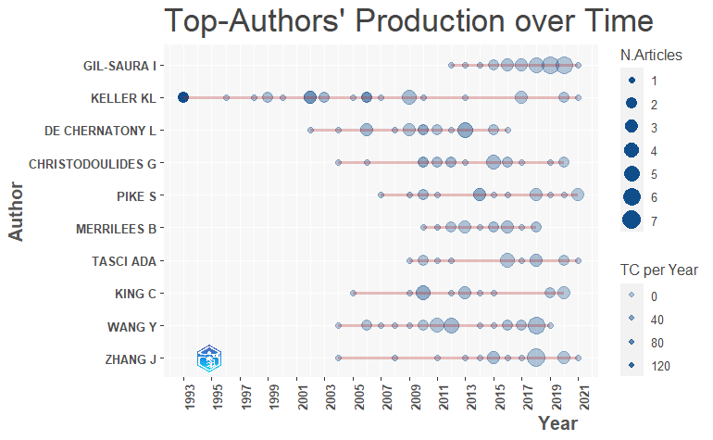
Productivity over Time
Notes:
plots the authors’ production (in terms of number of publications, and total citations per year) over the time.

Slide 68
Most Cited Paper
Paper | DOI | TC | TCperYear
KELLER KL, 1993, J MARK | 10.2307/1252054 | 4717 | 162.66
AAKER DA, 1996, CALIF MANAGE REV | 10.2307/41165845 | 1297 | 49.88
YOO B, 2000, J ACAD MARK SCI | 10.1177/0092070300282002 | 1264 | 57.45
YOO B, 2001, J BUS RES | 10.1016/S0148-2963(99)00098-3 | 1140 | 54.29
KELLER KL, 2006, MARK SCI | 10.1287/mksc.1050.0153 | 903 | 56.44
VERHOEF PC, 2009, J RETAIL | 10.1016/j.jretai.2008.11.001 | 879 | 67.62
ERDEM T, 1998, J CONSUM PSYCHOL | 10.1207/s15327663jcp0702_02 | 853 | 35.54
KELLER KL, 2002, J CONSUM RES | 10.1086/346254 | 831 | 41.55
WHAN PARK C, 2010, J MARK | 10.1509/jmkg.74.6.1 | 808 | 67.33
Notes:
Top Manuscripts per citation
Second paper is Customer Evaluations of Service Complaint Experiences: Implications for relationship Marketing

Slide 69
Most Productive Countries
Country | Articles | Freq | SCP | MCP | MCP_Ratio
USA | 746 | 0.2017 | 631 | 115 | 0.154
CHINA | 559 | 0.1512 | 499 | 60 | 0.107
UNITED KINGDOM | 219 | 0.0592 | 180 | 39 | 0.178
SPAIN | 183 | 0.0495 | 140 | 43 | 0.235
AUSTRALIA | 175 | 0.0473 | 142 | 33 | 0.189
KOREA | 162 | 0.0438 | 112 | 50 | 0.309
INDIA | 154 | 0.0416 | 129 | 25 | 0.162
FRANCE | 91 | 0.0246 | 66 | 25 | 0.275
GERMANY | 89 | 0.0241 | 66 | 23 | 0.258
MALAYSIA | 71 | 0.0192 | 58 | 13 | 0.183

Slide 70
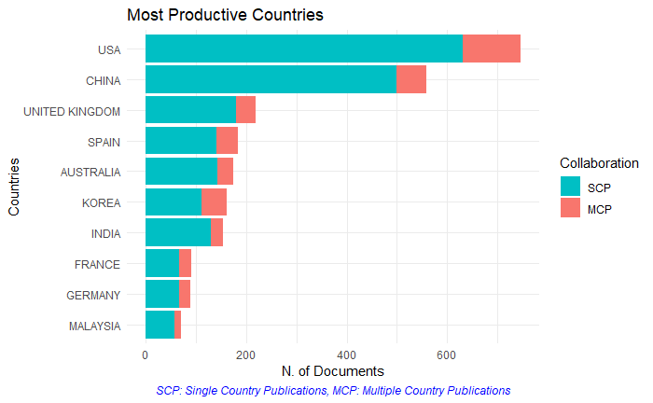
Most Productive Countries

Slide 71
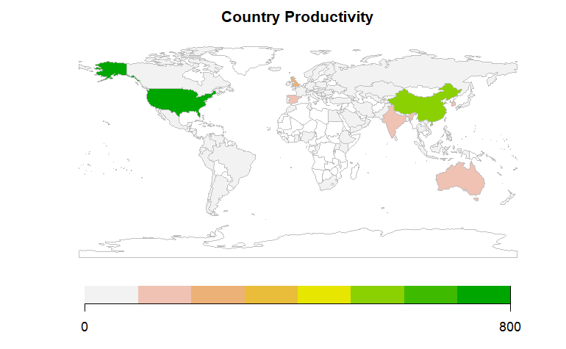
Country Productivity

Slide 72
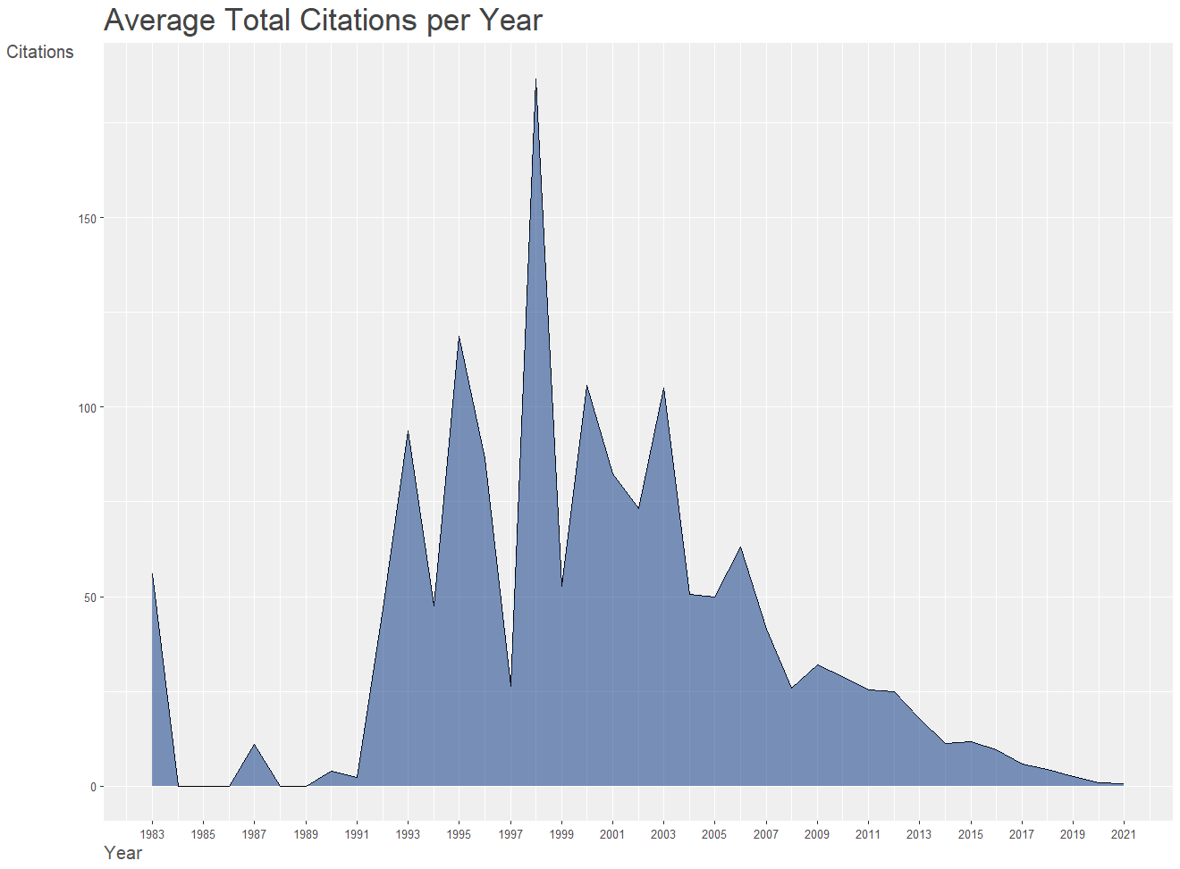
Average Total Citations per Year

Slide 73
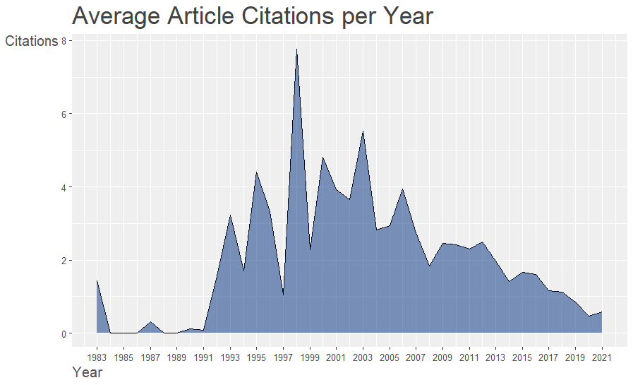
Average Articles Citation per Year

Slide 74
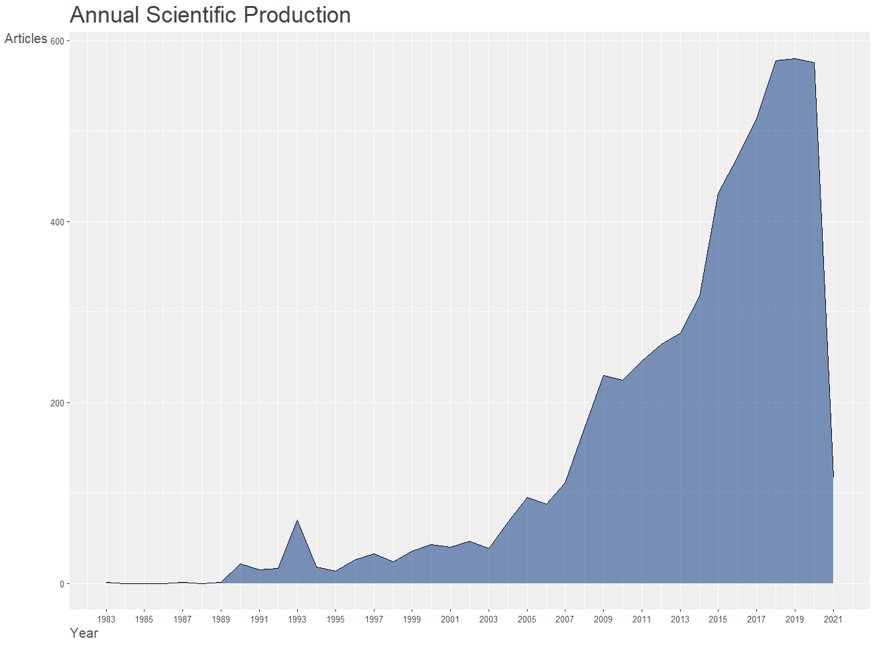
Annual Scientific Production

Slide 75
Top Keywords
Keywords | Freq
BRAND EQUITY | 1706
BRAND VALUE | 345
BRAND | 281
BRAND LOYALTY | 267
BRAND IMAGE | 234
BRANDING | 230
BRAND AWARENESS | 192
SOCIAL MEDIA | 190
BRAND MANAGEMENT | 181
BRANDS | 163
Keywords | Freq
MARKETING | 127
ADVERTISING | 123
PERCEIVED QUALITY | 121
LOYALTY | 117
CORPORATE SOCIAL RESPONSIBILITY | 111
CONSUMER-BASED BRAND EQUITY | 96
PURCHASE INTENTION | 95
CONSUMER BEHAVIOUR | 93
CUSTOMER-BASED BRAND EQUITY | 93
CUSTOMER SATISFACTION | 80

Slide 76
Top Journals
Sources | Articles
JOURNAL OF BUSINESS RESEARCH | 152
JOURNAL OF PRODUCT AND BRAND MANAGEMENT | 143
JOURNAL OF BRAND MANAGEMENT | 116
EUROPEAN JOURNAL OF MARKETING | 89
INDUSTRIAL MARKETING MANAGEMENT | 55
JOURNAL OF RETAILING AND CONSUMER SERVICES | 54
INTERNATIONAL JOURNAL OF CONTEMPORARY HOSPITALITY MANAGEMENT | 48
ASIA PACIFIC JOURNAL OF MARKETING AND LOGISTICS | 46
JOURNAL OF ADVERTISING RESEARCH | 46
JOURNAL OF PRODUCT & BRAND MANAGEMENT | 46

Slide 77
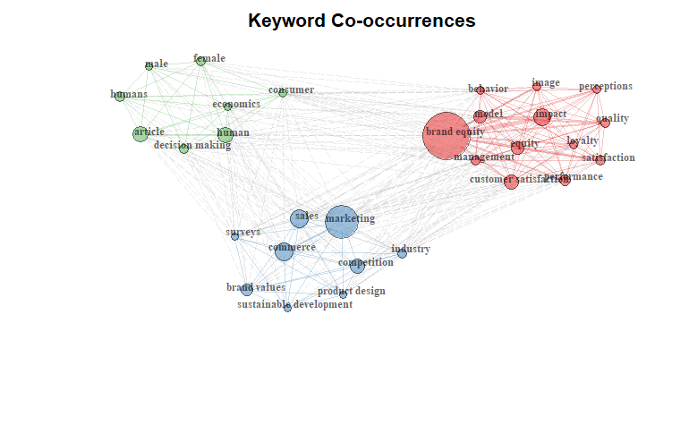
Keyword Co-occurences
2. Brand equity in the CB domain
1. Measurement of brand equity
3. Brand equity in the marketing context
Notes:
bigger context and impact of brand equity,
measurement of brand equity
CB domain.

